Slide 1
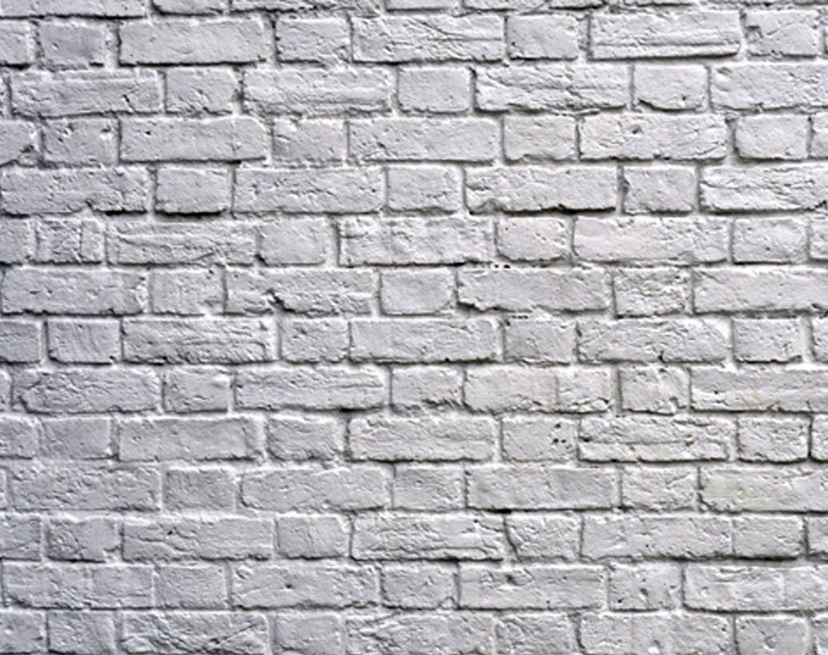
The Art of Drying Paint Watcher
By Savva Popov

Slide 2
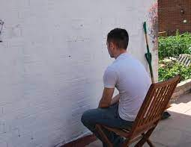
About the job
Purpose of the watching paint dry?
What industries require paint watcher?
Most boring job
Well paid?
Tools

Slide 3
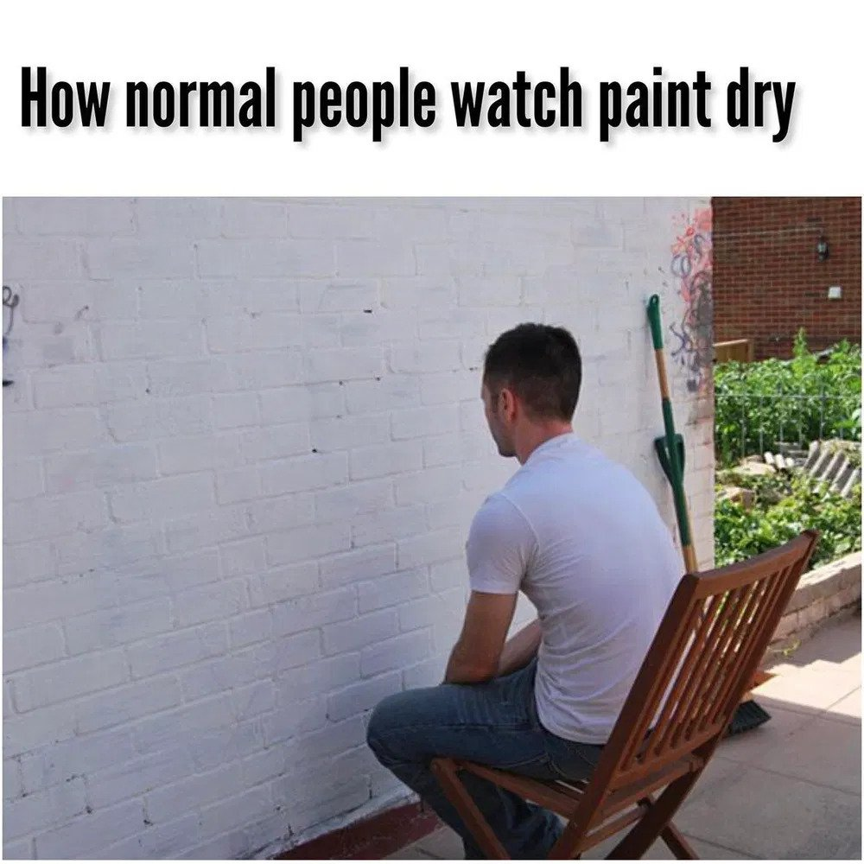
About the person
What qualities should The Watcher have?
Education???
Career growth
Secure and comfortable job?

Slide 4
Thank you for your attention
Source:
I made it up

